Slide 1
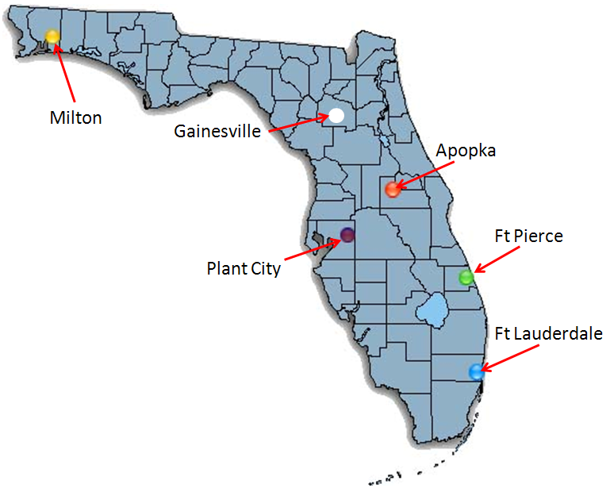
Student Evaluation Scores for Courses Delivered by Interactive Videoconferencing
Mark Rieger
Kirby Barrick
Elaine Turner
College of Agricultural and Life Sciences
University of Florida

Slide 2
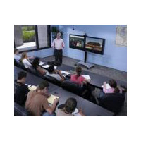
Statewide Programs = majors taught in 2+ places
Interactive Videoconferencing, IVC [Polycom]
http://webdev.ifas.ufl.edu/icsvideo/CALSRecruit/CALS_pierce.html

Slide 3
CALS Statewide Programs

Slide 4
IVC usage, UF
 | 2004 | 2008
Total IVC sessions | 215 | 5695
Total IT support staff for IVC | 1 | 2
Sessions per staff | 215 | 2848
Instruction, as % of total IVC sessions | 45% | 30%
Source: Office of Academic Tech, UF
Notes:
Broadband traffic increase
Scheduling – 4 nights per week, 3 hrs at a time

Slide 5
Changes in delivery platforms, nationwide
Year | Percent of 2 and 4-year institutions using IVC as the primary delivery platform
2001-02 | 70
2006-07 | 23 [51% not using it at all]
Source: NCES
Notes:
Age of IVC peaked somewhere in late 1990’s, early 2000’s, then lost ground substantially as internet platforms improved over the last decade.

Slide 6
Problems with IVC
Evening classes, 3 hrs once/week
  No technical staff available
  Attention span
  Limits course sharing to ~8/week
Dropped audio and/or video signals
Poor resolution
Student evaluations lower at remote sites

Slide 7
Objectives
Determine if evaluation scores differ between live and remote sites
…and if so
Is the magnitude of the difference large enough to:
  affect faculty performance evaluations
  warrant a change in DE delivery technology

Slide 8
Methods
Convenience sample of student evaluations: 22 cases during 2005-08
  10 different instructors representing 4 sites
  14 different courses
  1 course 3x, 6 courses 2x
Stats: non-parametric Wilcoxan signed rank test on differences [live –remote]

Slide 9
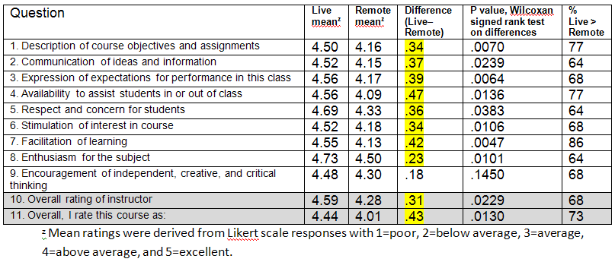
Results
From 2005-2008, n=22

Slide 10
Results
 | 10. Instructor overall | 11. Course overall
Live site | 4.59 | 4.44
CALS mean (Fall 2008) | 4.35 | 4.16
Remote site | 4.28 | 4.01
From 2005-2008, n=22

Slide 11
Discussion
Faculty were right!
All ratings were close to college-wide means
  Practical significance? Serious disadvantage?
  Reasonable for faculty to address the issue
Notes:
Go back and show that means of live+remote in P&T would be basically the same as CALS means.

Slide 12
Discussion
Results agree with:
  Clow (1999), Chisholm et al. (2000) – lower evaluations at remote than live with IVC.
Results disagree with:
  Spooner et al. (1999) – IVC has no consistent effect on student evaluation scores.
Is it the technology per se or the pedagogy/methodology that goes with?
Notes:
Clow 1999 – J. Marketing Ed. 21:97. UNC-Pembroke; several business courses at grad and undergrad level. Statistically lower evals from remote sites 75% of the questions, mostly from undergrads, not grads.
Chisholm et al 2000 – Amer. J. Pharmaceut. Ed 64:152. Two Pharm courses delivered between MCG-Augusta and UGA-Athens. 73% of the time, live was better than remote, but not statistically signif.
Spooner et al. (1999) reviewed 11 studies conducted prior to 1999 and found that six showed no differences in student evaluations between live and remote IVC sites, three showed IVC worse than live, and two showed IVC better than live instruction.
Another way to say last question – if faculty had received proper training, would the results have turned out this way?

Slide 13
Conclusions
IVC affects evaluation scores, but Statewide faculty are doing a great job despite technology
Switch evaluation forms? (Roberts et al. 2005)
  separates technology from teaching
Switch platforms – go online
  Less problematic than IVC
  Reach new markets
  Student satisfaction equal or higher (Allen et al. 2002, Bernard et al. 2004)
  Student achievement higher (Bernard et al. 2004, DOE 2009)
Notes:
Allen and Bernard papers – meta analyses of satisfaction and achievement, de vs F2F

Slide 14
Statewide Programs
2010 Annual Meeting
Vision Statement
Transform current programs to predominantly asynchronous,
internet-based course delivery over three years
Blended programs:
  Online + Critical Live

