Slide 1
Training emergency responders to handle equine-related incidents
C.A. Shea Porr, J.A. Brown, and R.K. Splan
Virginia Tech MARE Center
Middleburg, VA
Notes:
Unintentional actions – police responded to horses loose on highway, inadvertently “chased” horses into oncoming traffic. Leads to an educational opportunity.

Slide 2
Vets Vs. emergency responders
Notes:
There are an estimated 9.2 million horses in the United States, many of them traveling in trailers down the highway or carrying riders over trails in parks and forests. With this many horses and an active equine community, there’s a good chance that an emergency involving a horse will happen in your area. Animal-related emergencies are somewhat unique, as it’s often unclear who has the proper training or authority on a scene or what techniques are appropriate to use when trying to assist an animal.
Most people assume a veterinarian should be the primary go-to person at a rescue site. However, while veterinarians are experts on animal medicine and large animal behavior, they are not often trained in technical rescue of down or trapped animals. As such, veterinarians can impede a rescue and put themselves in danger by attempting to help a trapped or injured animal using inappropriate methods.
Emergency responders often lack familiarity with horses or other large animals and are unaware of inherent dangers associated with the same. They may extrapolate methods used to rescue humans or small animals to larger ones, potentially exacerbating damage to the animal and danger to the rescuers. They may also unintentionally make a scene worse when animals frightened by lights and sirens run away. They do, however, have the technical expertise and equipment to rescue a downed or trapped animal.
Given stories resulting from hurricane Katrina and reports of poorly performed animal rescues in the news, and knowing NoVA is “Horse Country”, a survey was developed to ascertain whether or not there was a need for training. Education of both of these groups on scene control and proper techniques could improve outcome of these stressful situations.

Slide 3
Preliminary data
Hypotheses: Responders in NoVA would:
have encountered horses during an emergency
have little or no training with horses
Pilot Survey
6 counties – EMS, Sheriff/Police, Animal Control
Results
Response rate
Over 60% had responded to events involving horses
Only 21% had any training handling horses
Less than 25% were comfortable with the thought of handling horses

Slide 4
Emergency responder horse handling training
Classroom
Equine Behavior 101
What to do Until the Vet Arrives
Basic Equine First Aid
Hands-on
Handling
Moving around obstacles
Grooming
Trailers
Basic First Aid
Notes:
Program objectives - to improve knowledge and comfort level of emergency responders where handling horses was concerned.

Slide 5
Program evaluation
2 years, 8 programs, 137 participants
120 program surveys (pre- and post-)
Pre-program survey
Over 82% had no formal training with horses
15% “not comfortable” around horses
Post-program survey
All at least “somewhat comfortable” with horses
94% had increased comfort level with horses
Follow-ups
Notes:
Pre – ascertain expectations, previous training and/or experience with horses, and comfort level
Post – ascertain knowledge gained
Follow-up survey being designed to find out if this information has been used/useful and whether or not the participant went on to get further training.

Slide 6
conclusions
Program appeared to
Improve knowledge of equine behavior, handling, and basic first aid
Improve confidence in horse handling
Considerations
Northern Virginia – “Horse Country”
Horses in training not stressed
Follow-up needed
These learners different?

Slide 7
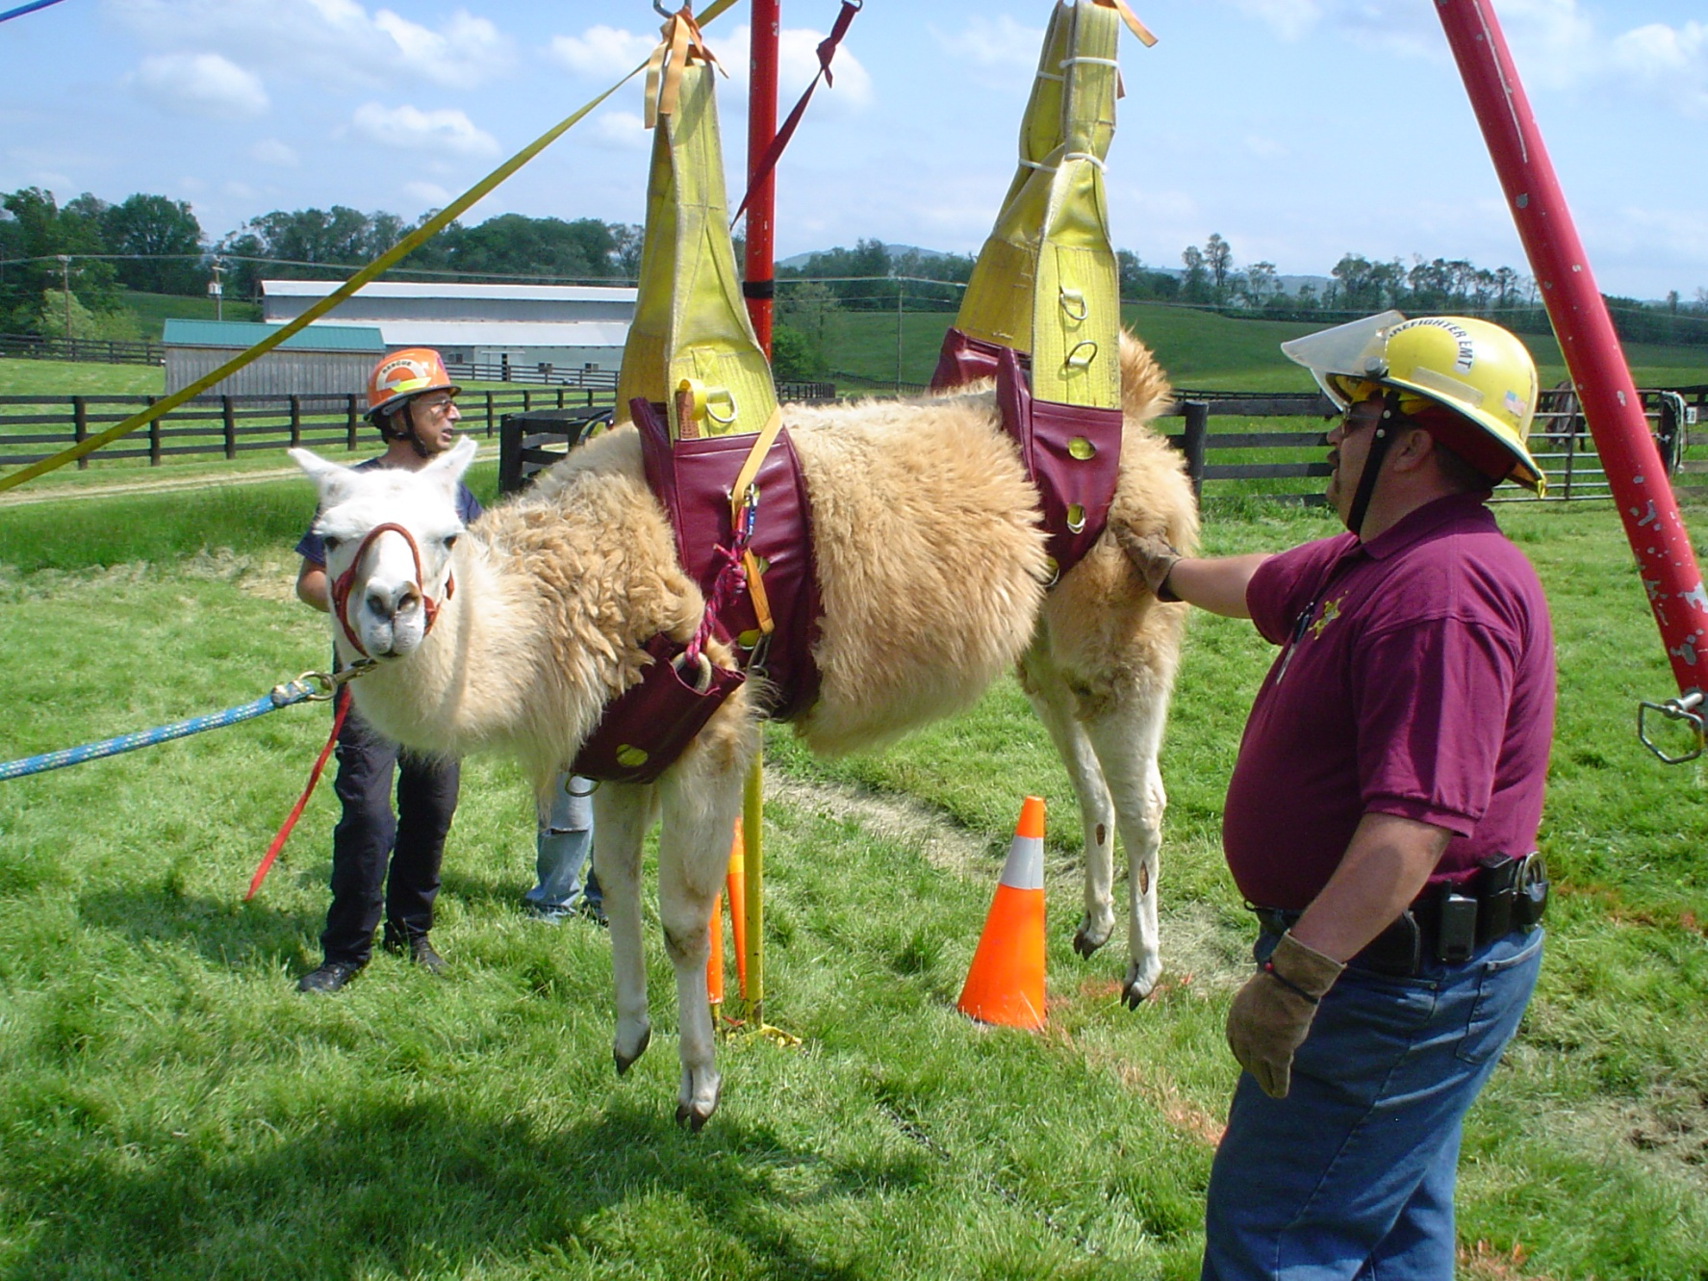
Questions?

