Slide 1
Student Development and Usage of a Dust Explosion Simulator for Teaching Agricultural Safety
Duane Bajema, James Korver, and Lane Maars
Dordt College
Sioux Center, Iowa

Slide 2
Background
Teach a ½ semester course
  Orientation to the Ag Program
  Teach agricultural safety
    Want to encourage students to accept their responsibility as future professionals to improve safety record in agriculture

Slide 3
Introduction
Freshmen course – Orientation and Safety
Junior/Senior course – Directed Study
Students wanted to enhance the freshmen course
Need and opportunity

Slide 4
Introduction continued
Ag Safety course – what do you include?
Dust explosion info recently added
-Students lack awareness of the danger -Recent incidents
-school shop
-2 local elevators
Video shows graphic danger of dust

Slide 5

Dust Explosions

Slide 6
Objectives
Develop effective delivery of the information
  Develop and build a portable simulator for visual effect and improved learning
  Develop a curriculum using simulator
Use simulator and curriculum to deliver the information

Slide 7
Methods
Design and build a functional simulator
  Research existing simulators – UN-L
  Make design improvements and build a simulator
Develop curriculum and implement it
    College, High Schools, fire departments, elevators

Slide 8
Methods
Used the simulator and curriculum for educational purposes
  Administer pre-test and post-test evaluations
Made a video for publication on the internet

Slide 9
Results of three students 2009
Designed simulator
Functioned but had flaws
  Dust did not go into suspension well
  The quality of the explosions was unpredictable
  Metal and plexiglass had warping problems
Disappointment – project die???

Slide 10
Results 2010 – 2 students
Took on challenge of redesign
Basis for discussion – how research and development builds on work of others
Two new students accepted the challenge of to redesign the simulator and curriculum

Slide 11
Fundamentals
The requirements for a dust explosion
  Dust as fuel
  Dust suspension
  Oxygen
  Ignition source
  Closed area
Video clip – dust and flame

Slide 12
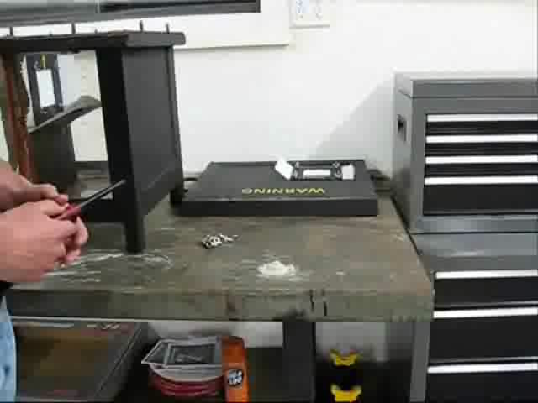
Video clip of function

Slide 13
Basic design Video
Students made video that is available on web
Published on YouTube
  http://www.youtube.com/watch?v=FYjqr1xjxy0
  Dust Explosion Simulator – key word
Portion of video

Slide 14
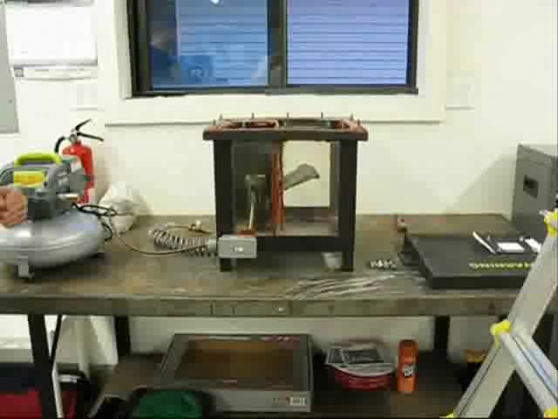
Basics of Simulator

Slide 15
Results
The simulator is very usable and works in a very predictable and safe manner.
Testing results showed the curriculum to be successful in increasing student knowledge of dust explosions.

Slide 16
Pre-Test and Post-Test
Test administered 1 week prior to presentation and 1 week after presentation
Pre-Test scores = 58.6%
Post-Test scores = 85.8%
Concerns – Test construction and data collection

Slide 17
Areas For Future Work
Work with different types of agricultural dust
  Ex. Sugar, soybean, different kinds of wood dust, and wheat
Publish information on how to build a simulator
Continue to demonstrate the simulator at local high schools and agriculture safety events to raise awareness of the danger.

Slide 18
Acknowledgements
Students – 2009:
  Jon Vankeulen, Joel Prins, Ben Werkhoven
Students – 2010:
  James Korver, Lane Mars
Funding Sources
  Sanford Medical Center of Sheldon, IA
  Hull Fire Department of Hull, IA
  I-CASH Foundation of Des Moines, IA

Slide 19
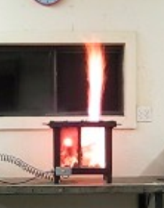
Questions?

