Slide 1

Diversity in Higher Education:
Awareness to Action
Dustin Petty
Academic Advisor
Liberty Hyde Bailey Program
Michigan State University

Slide 2
Overview
Liberty Hyde Bailey Scholars Program Background
Research Focus
Findings and Trends
Shifting from Awareness to Action
Integrative Learning inside Traditional Classrooms

Slide 3

The Liberty Hyde Bailey Scholars Program
Founded in 1997 under College of Agriculture & Natural Resources at MSU
Developed with shared goal of transforming higher education, teaching and learning
Composed of undergraduate students, graduate and faculty fellows
ANR Learning Seminars (210, 310, 410) where students develop “top of the T” skills through both self-directed and project-based learning
Scholars decide what they want to learn, how they want to learn and how they want to assess their learning

Slide 4
BSP Background
Program based on students own capacity:
The Bailey Five Questions
Minor in Leadership in Integrated learning
Self-exploration, aid students in pursuing their learning interests
Seeks to be a community of scholars dedicated to lifelong learning - work together
Learning Assessment Model: envision, prepare, do, gather, reflect, and connect - tools used in creating collaborative learning
Program values Inclusion, Diversity, Scholarship, Community, Reflection, Voice, Space,
Engagement, Dialogue,
Joy, Creativity, Respect
Integrity, Learning
Learning Assessment Model

Slide 5
Research Background
Diversity is a program values
We are one of the most diverse units at Michigan State University

Slide 6
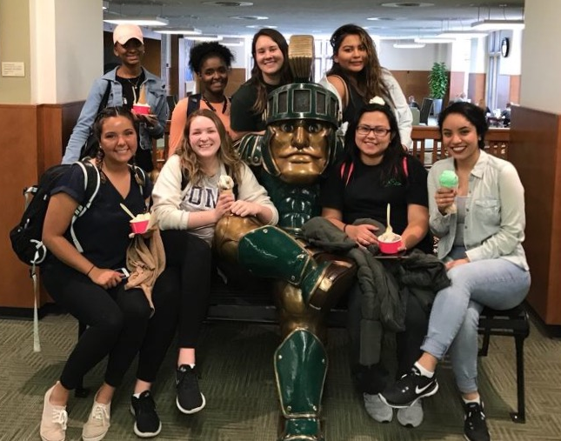
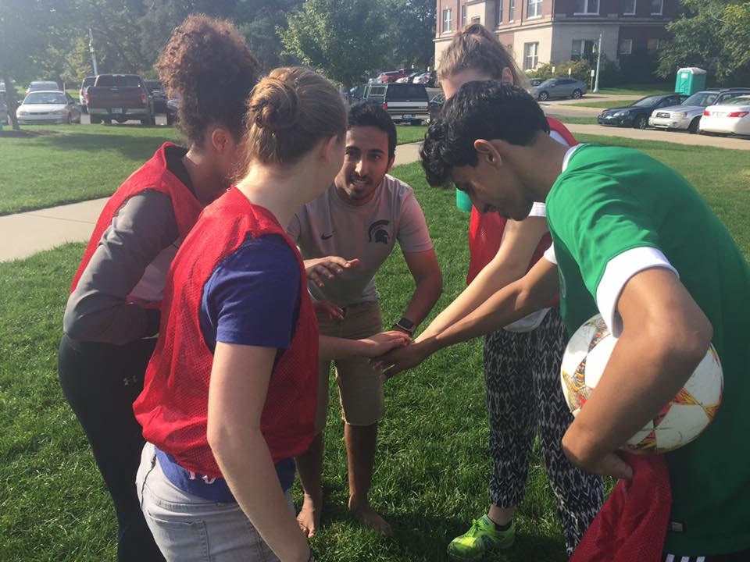
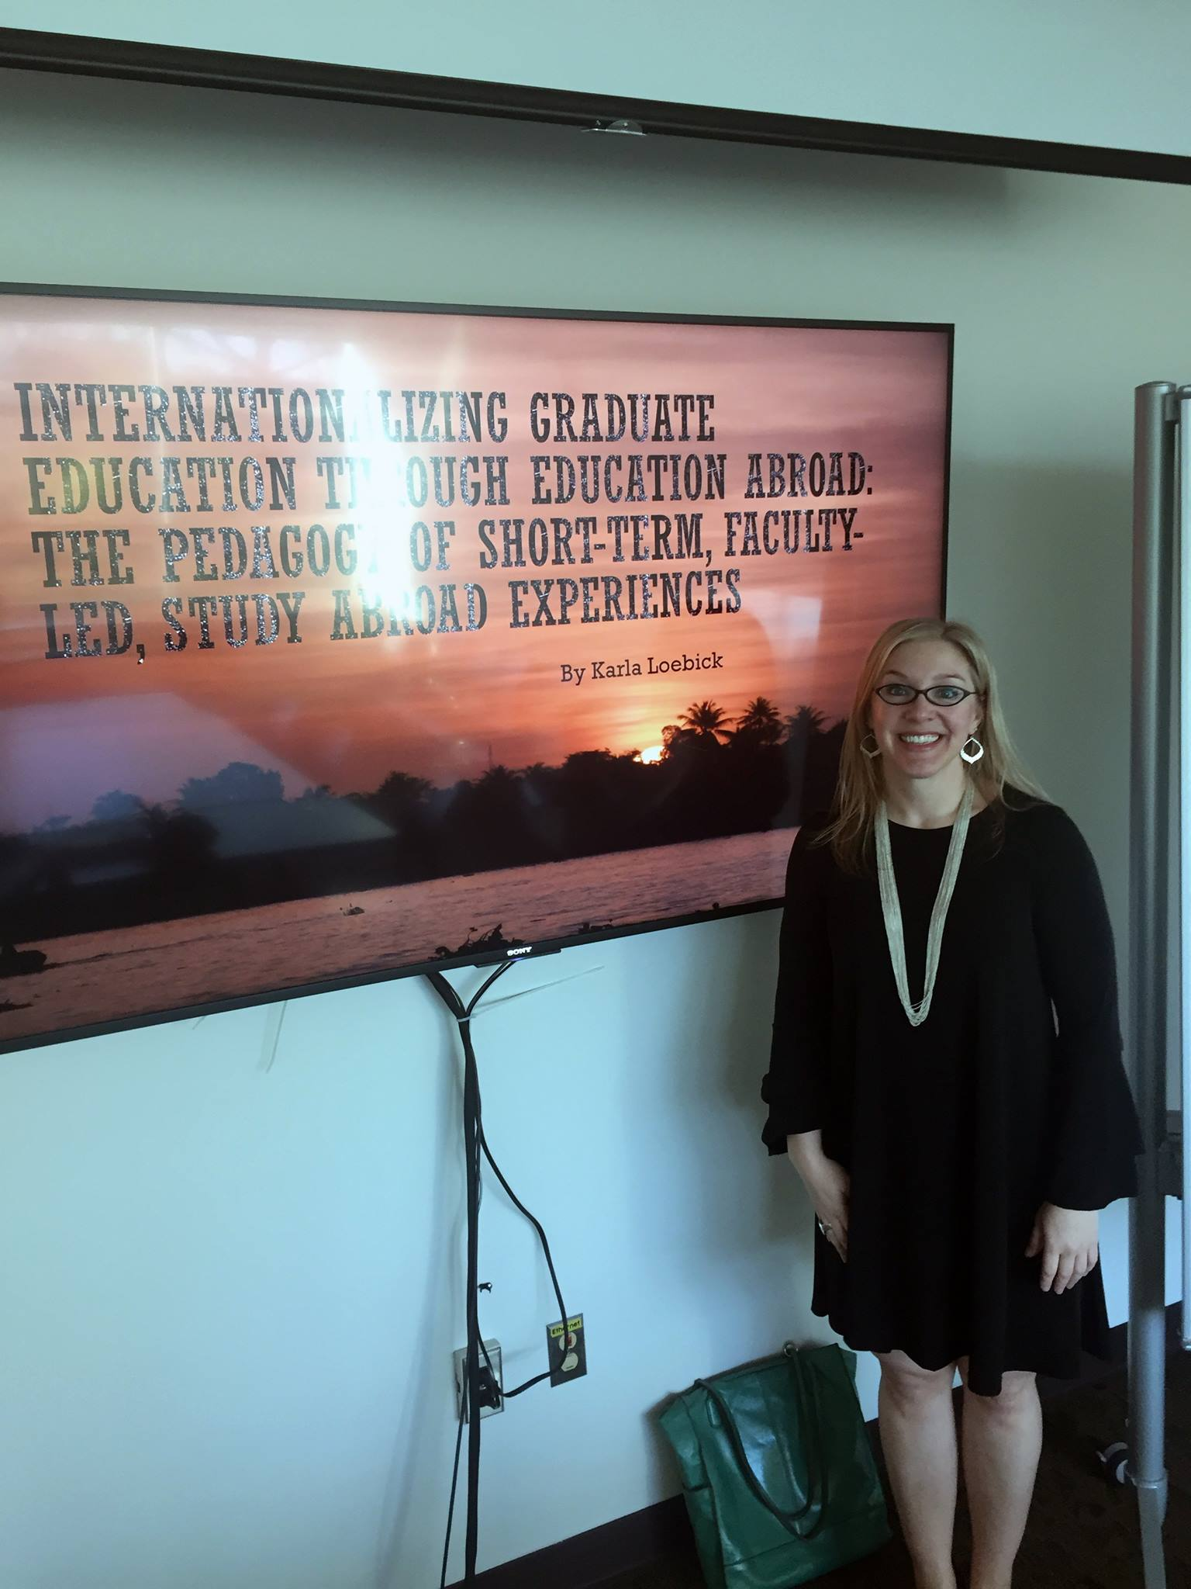
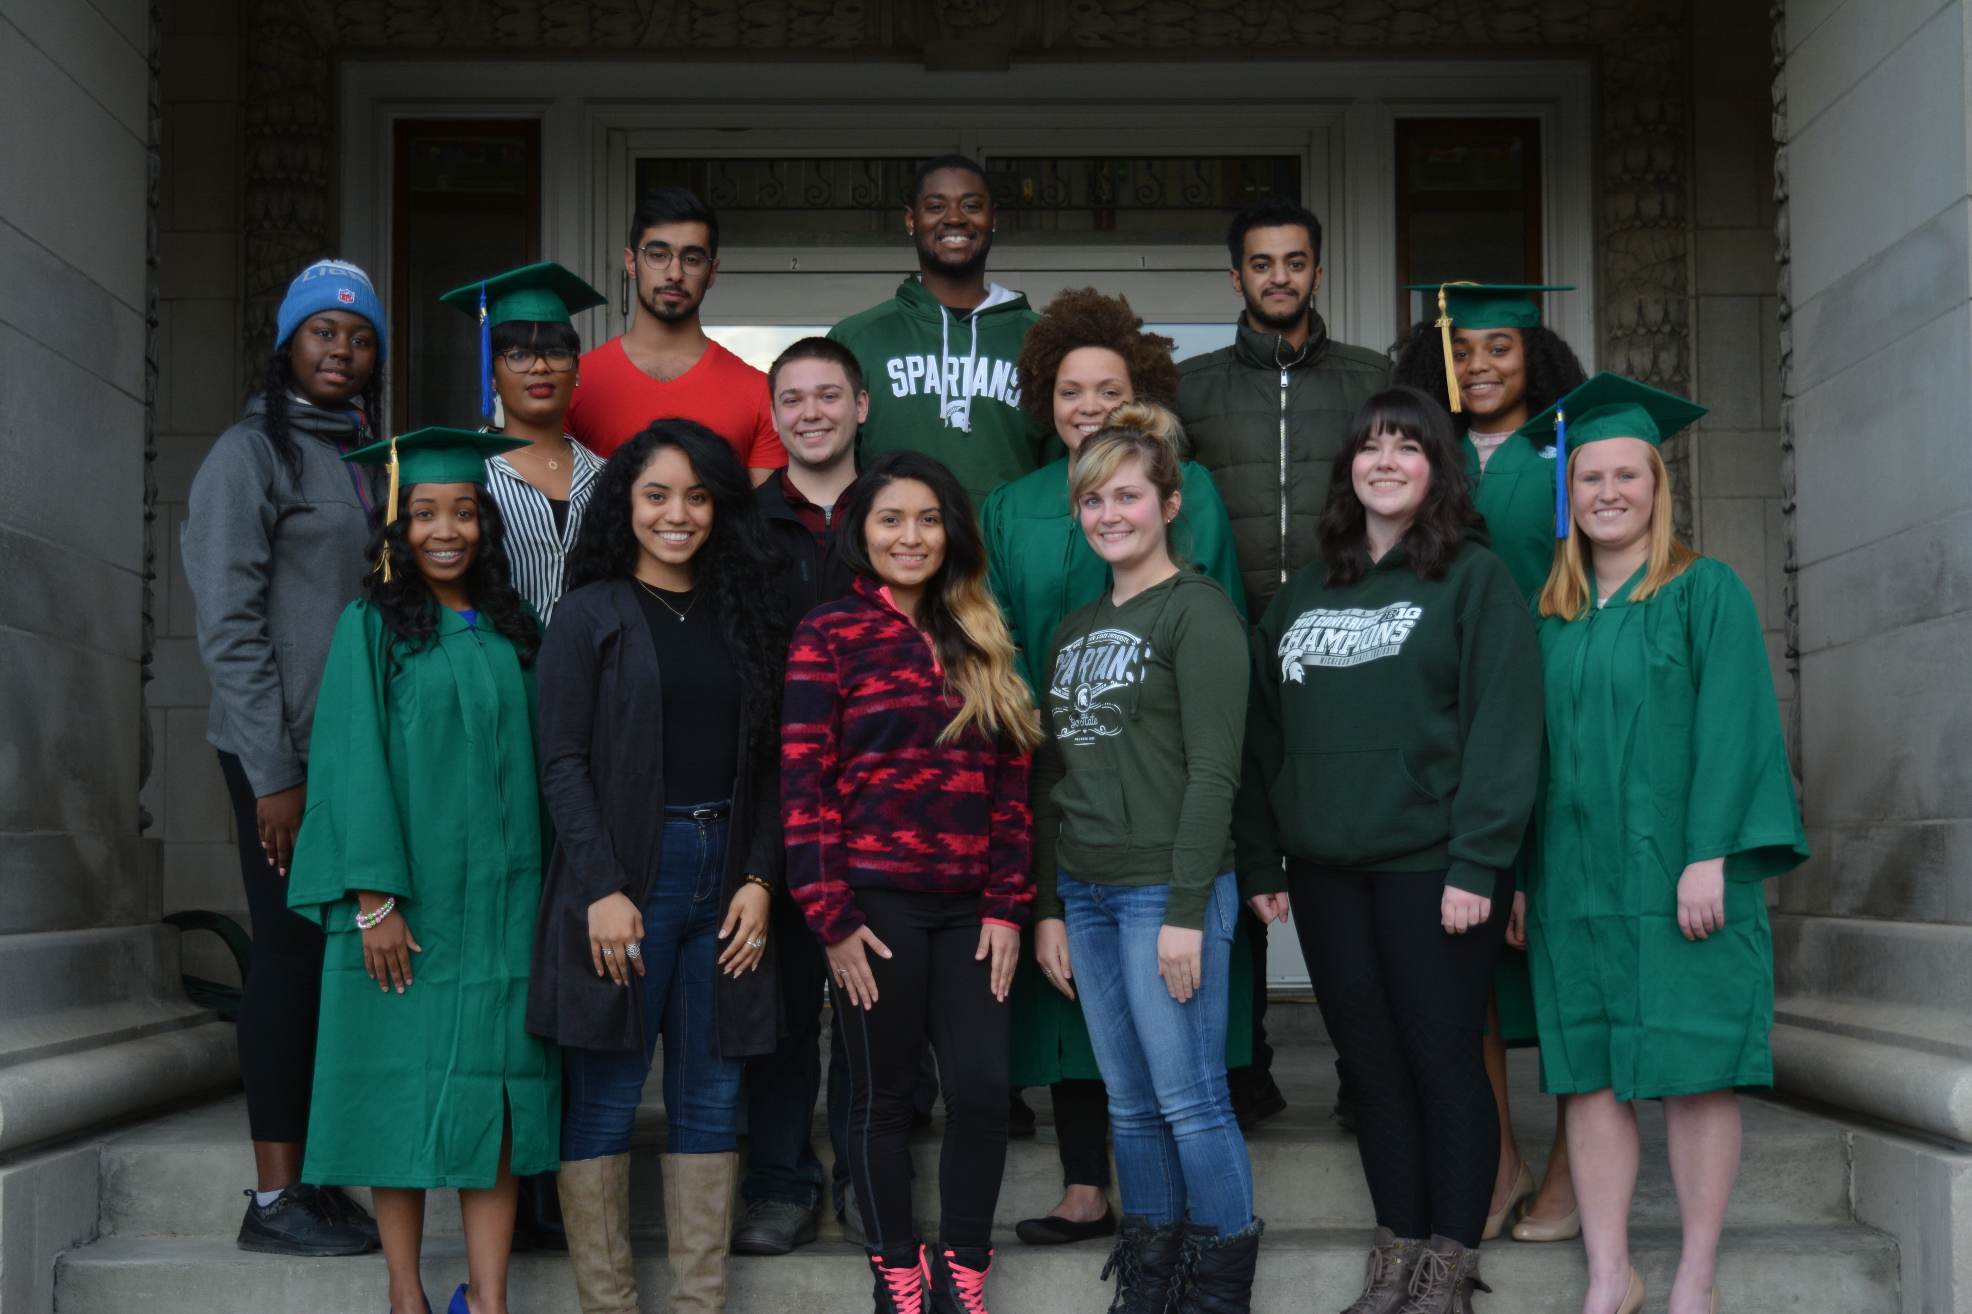
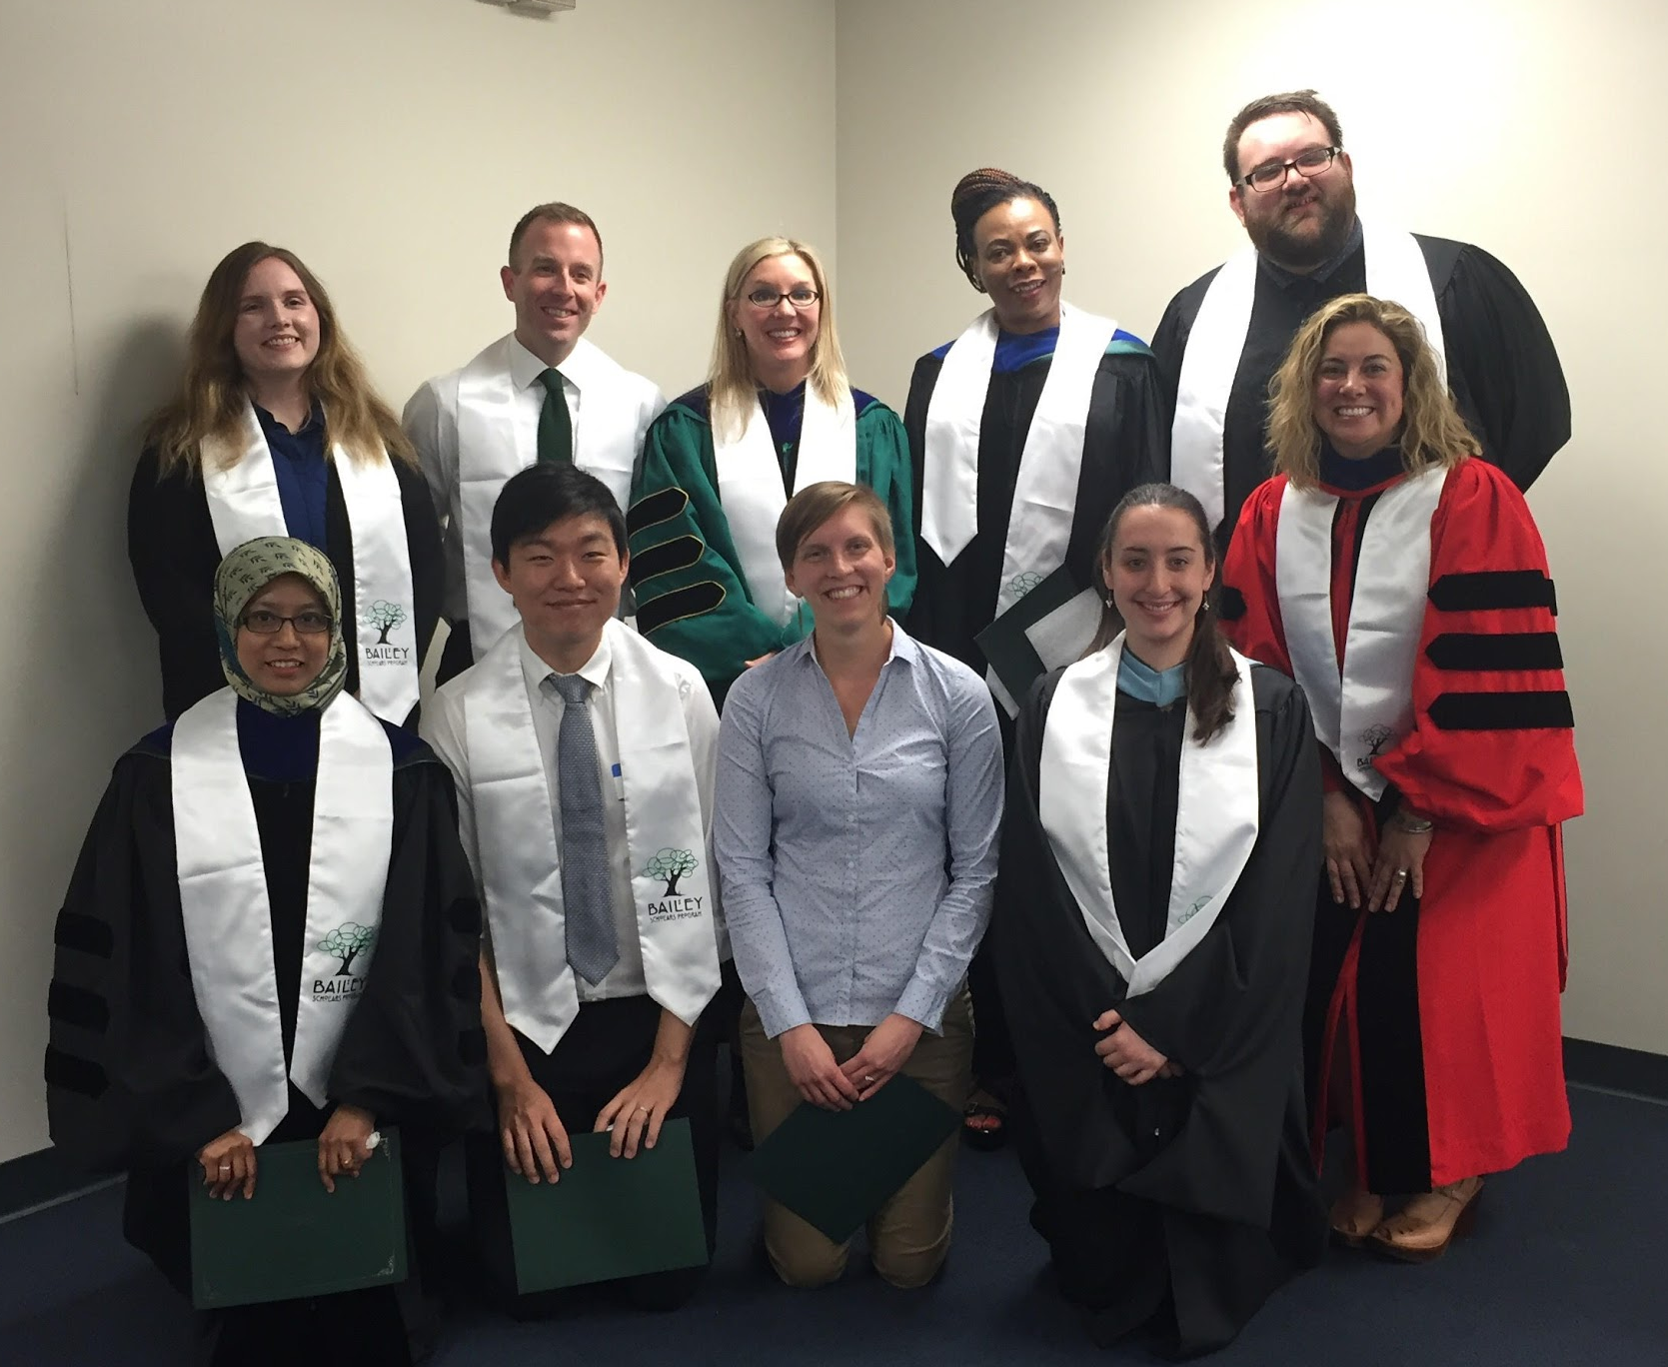
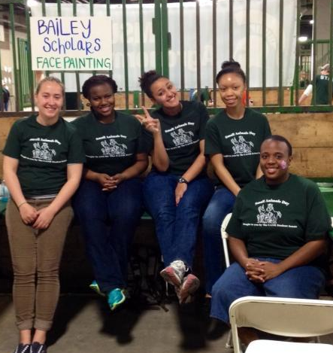
Research Background

Slide 7
Research Background
Diversity is a program values
We are one of the most diverse units at Michigan State University
Do our students feel the same?
Faculty and Graduate Fellows 2016-2017 (PI: Dr Jeno Rivera and Pauline Tobias)
  A survey assessing Bailey students perception of diversity and lived experience
  A total of 105 students 2016-2017 school year
  Respondents 60, completed survey 53 (n=53)

Slide 8
Research Questions Research Design
Mixed methods (SPSS)
Eighteen total questions (demographic items, both open and close ended)
  Definitions of diversity
  Reasons why students joined Bailey
  Students asked to provide and describe examples of why they view Bailey as a diverse learning community
How does Bailey students’ definition of diversity correspond with their lived experiences in Bailey?
How do students experience diversity when they participate in this program and how does that correspond with development?

Slide 9
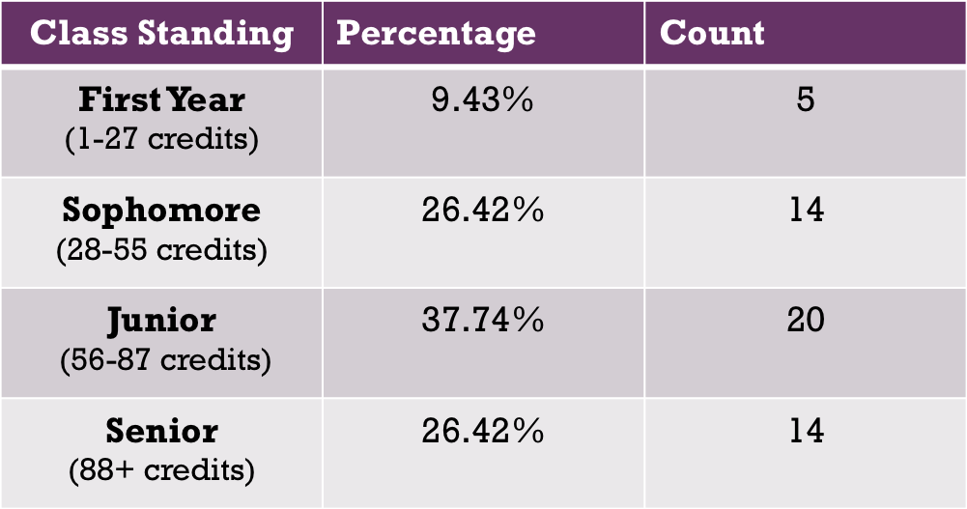
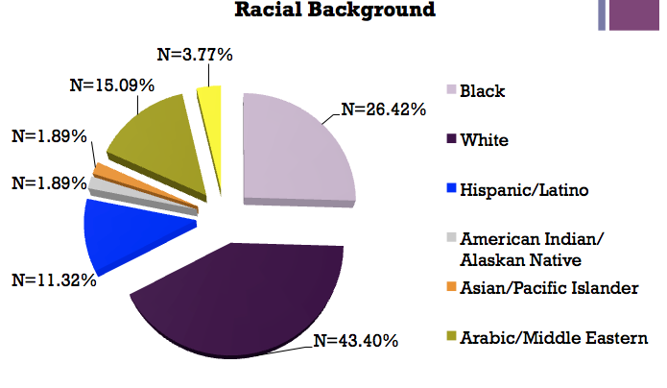
Demographics

Slide 10
Findings and Trends

Slide 11
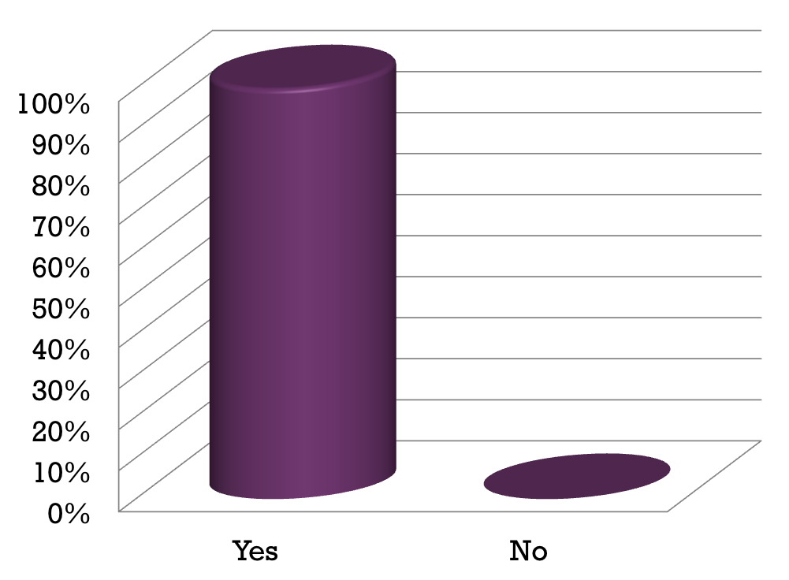
Bailey Scholars Program is Diverse
Vast majority of program participants believe Bailey is in fact a diverse learning community
98.11% compared to 1.89%

Slide 12
Students Join Mostly Due to Recommendation
Categorized student response options into four categories
Recommendation (family/friend/advisor)
Values
(Identification with program values)
Connections (to campus, resources, peers
Goals (boost GPA, earn a minor)
REASON JOIN | N (frequencies) | Percentages
Recommendation | 39 | 31.7
Values | 25 | 20.3
Connections | 34 | 27.6
Goals | 25 | 20.3

Slide 13
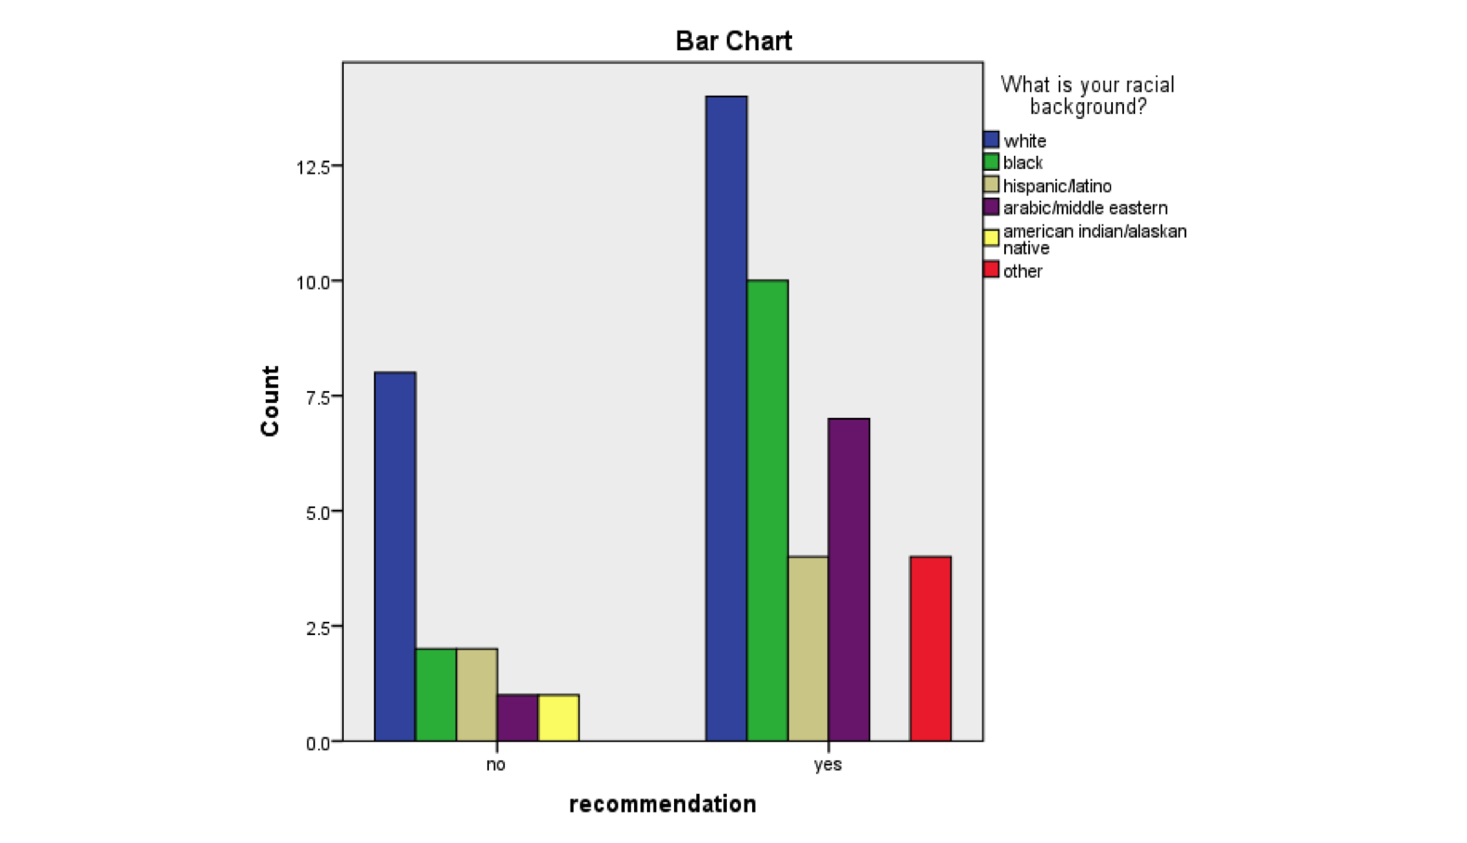
Racial Diversity on the
Basis of Program Recommendation
Students of color join mostly based on recommendation
White students join mostly based on their own decision

Slide 14
Definition of Diversity
Open-coding system
Pulled keywords frequently used in students responses to create seven different yet related categories corresponding with their definitions of diversity
“Diversity to me means being from different cultures and experiences”
“The understanding, acceptance, and respect of other's cultures, differences, and customs, in one living learning community.”
“a variety of different individuals, values, ideas, culture etc”
“People with different backgrounds, cultures and ideas being able come together.”
Differences/Variety
Background culture
Cultural characteristics
Experiences
Community
Respect/Acceptance
Values, views & ideas

Slide 15
Shifting From Awareness to Action

Slide 16
Diversity Means More
Diversity encompasses more than cultural background, gender identify, sexual orientation, etc.
Socioeconomic/financial means
Abilities (physical, mental, and/or emotional limitations?)

Slide 17
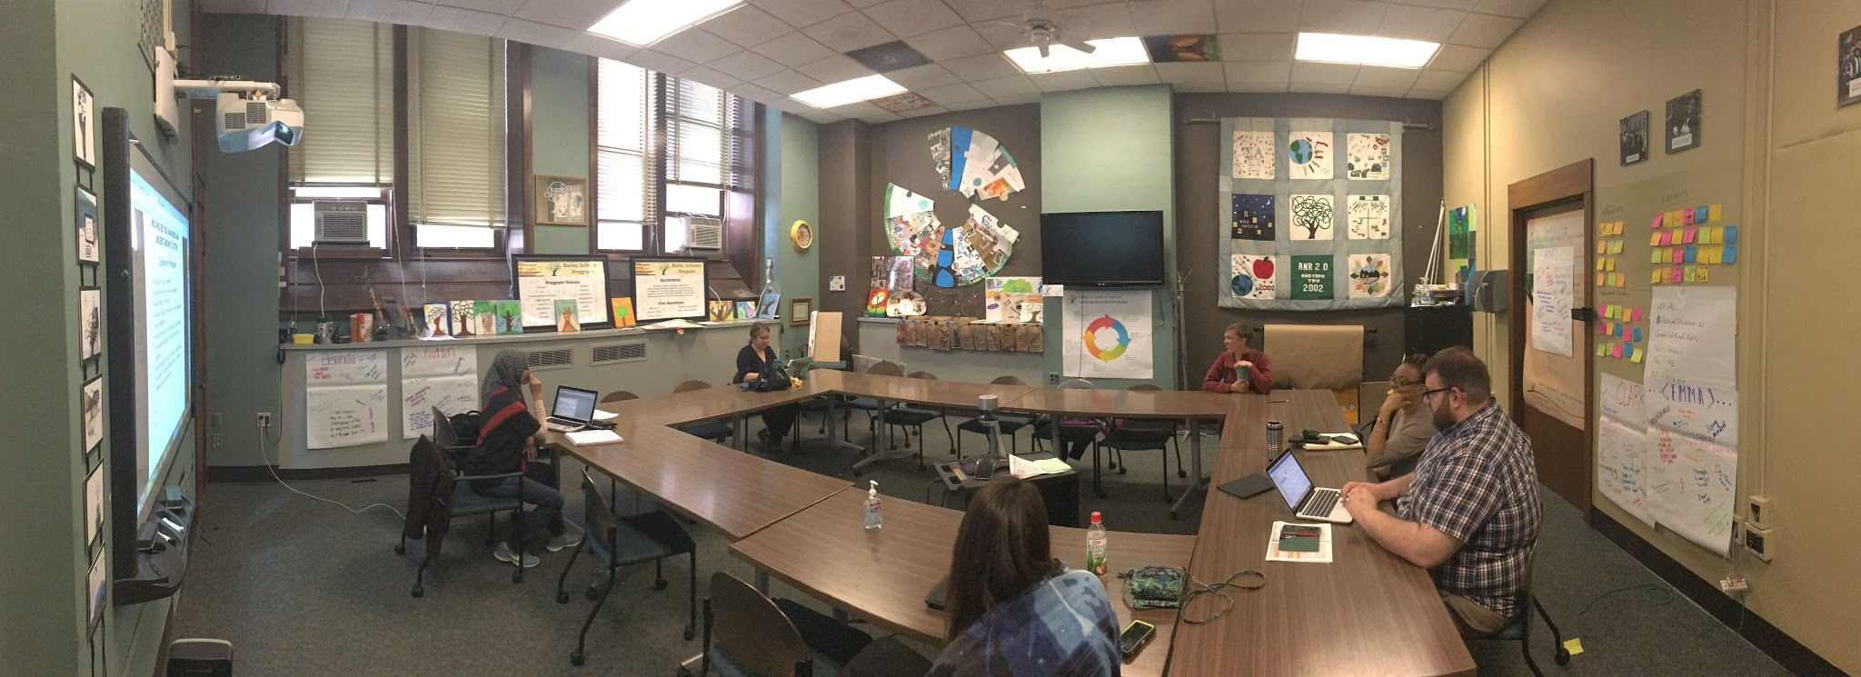
Integration of Awareness
Embrace differences among students
  Culture, values, their experiences outside BSP
Purposely integrate these differences into Bailey classroom
  Dialogue
  Expression
  Culture Week
Create inclusive space and conducive environment for continuous learning experience

Slide 18
Creating Diverse/Inclusive Learning inside Traditional Classrooms
Student involvement in creation of curriculum (whenever possible)
  Students more motivated to participate when they have chosen what to learn
Non-traditional learning assessments
  Reflections (written, oral, video or other media)
  Evidence of learning
Fostered independence
  Fostered by instructor
  Maintained between all learners

Slide 19

Question/Answer & Discussion
Faculty & Graduate Fellow Group:
Dr. Jennifer E. Rivera, Madeline Shellgren, Jessica Mestre, Pauline Tobias, Shairah Abdul-Razak, Hogeun Park, Alyssa Stepter, Greg Steele, Erin Pevan, Monica List, Dustin Petty, and Karla Loebick

