Slide 1
Identifying Critical Plant Science Skills:
An Industry Survey Approach
Brantlee Spakes Richter, University of Florida
Maya Hayslett, Iowa State University
Anissa Poleatewich, University of New Hampshire
Kathryn A. Stofer, University of Florida

Slide 2



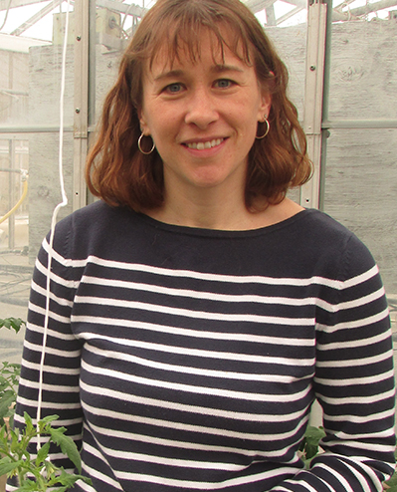

History & Acknowledgements
American Phytopathological Society
  Teaching Committee
  Office of Education
  Council
  Staff: Michelle Bjerkness, Cindy Scheller
USDA NIFA Higher Education Challenge Grant

Slide 3
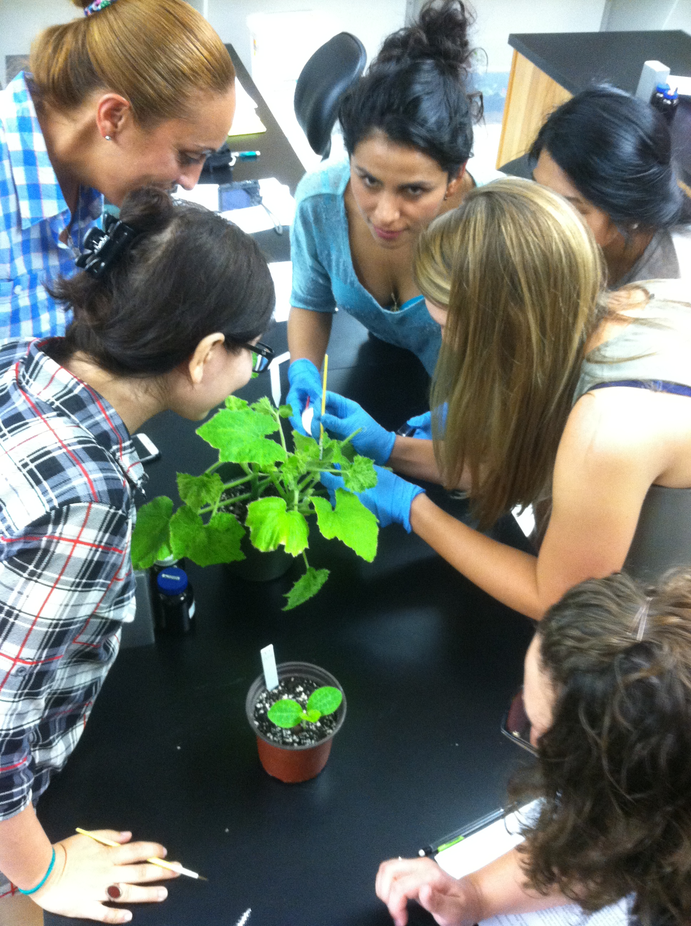
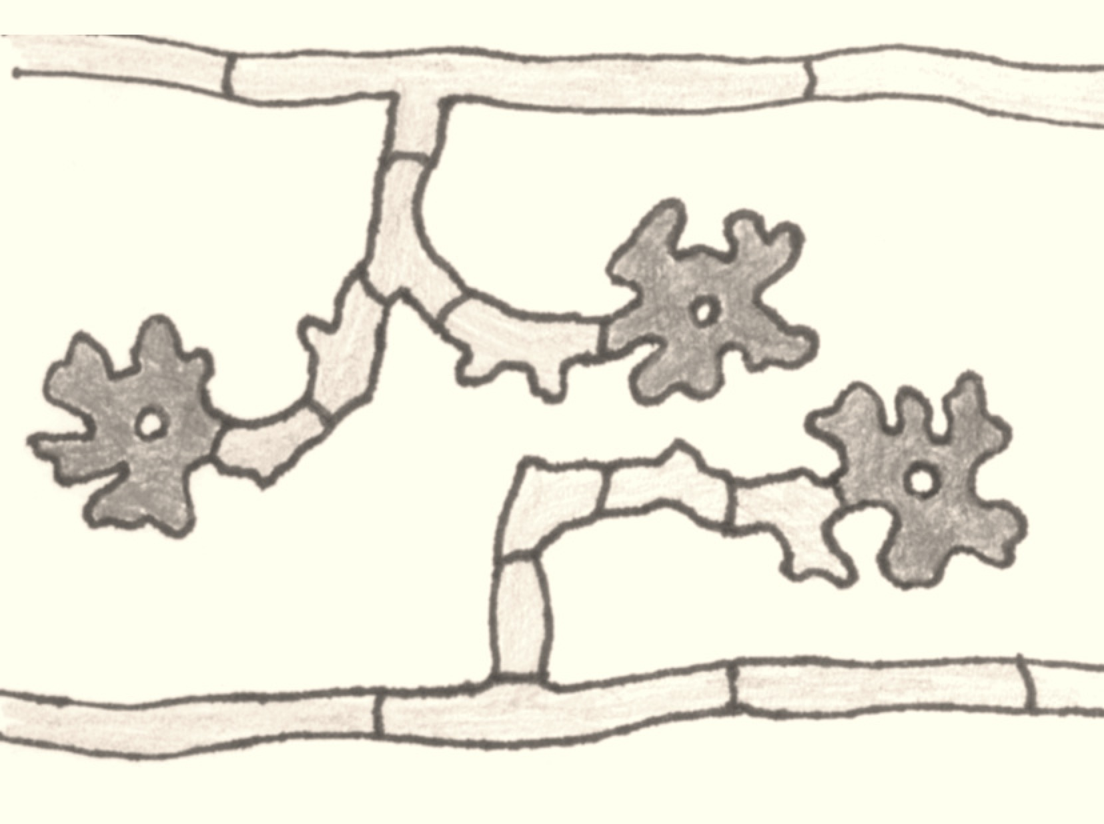
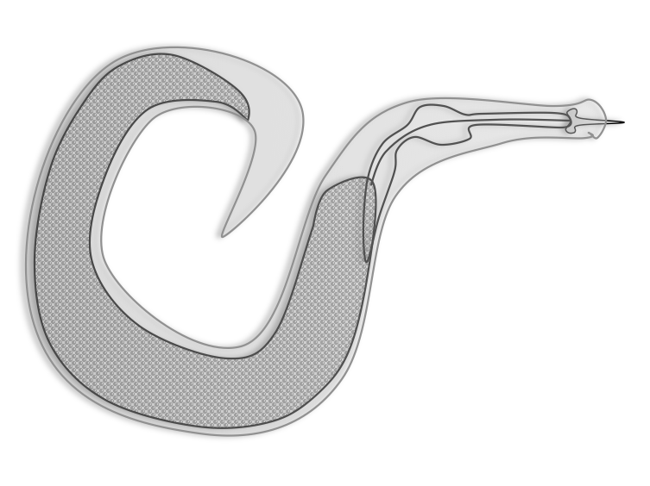
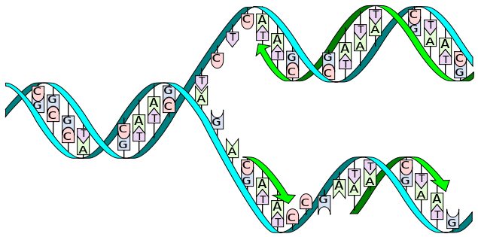
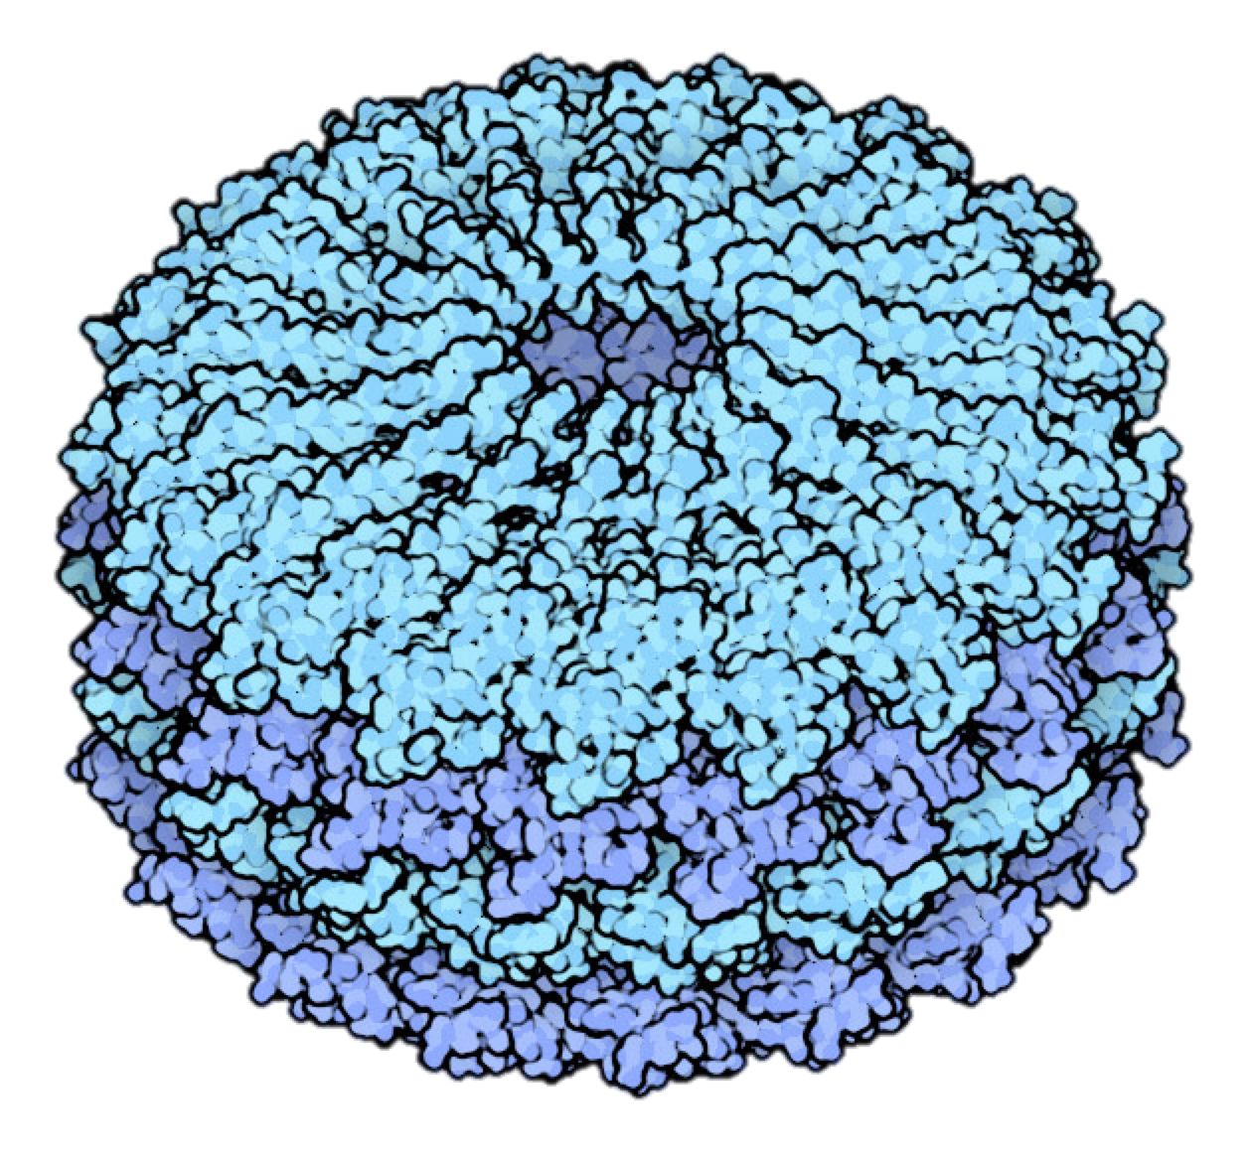
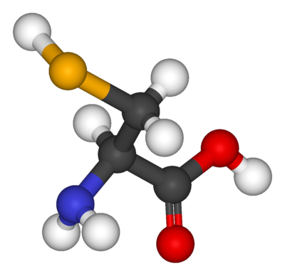
Plant Pathology
Plant Pathology
Microbiology
Mycology
Genetics
Nematology
Virology
Botany
Plant Anatomy
Plant Physiology
Biochemistry
Notes:
PLP is synthetic subject, requires foundational knowledge in multiple subject areas
PLP as a “found major” – not many undergrads major in PLP
Many PLS students take a course in JR or SR year

Slide 4


Take it and run…
Notes:
Students go in many directions from here, have very different needs and expectations from the course.

Slide 5
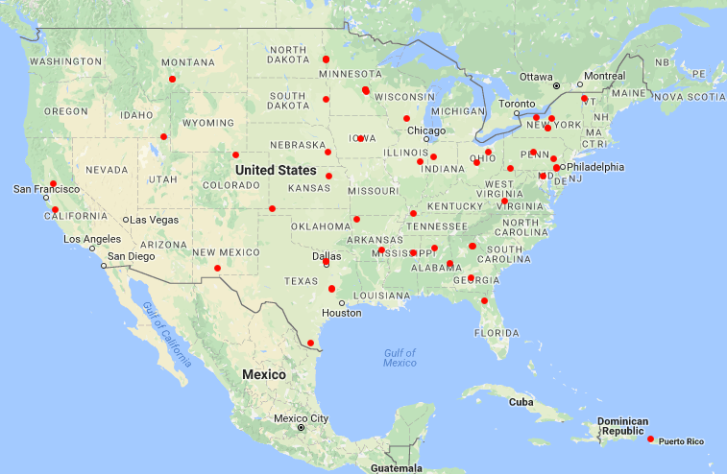
Questions:
What is being taught in intro/general Plant Pathology courses?
  Variability in concepts & skills?
  Variability in perspective & emphasis?
  Laboratory skills?
Biology
Plant Pathology
Environmental Studies
Notes:
Biology department in private liberal arts college vs. PLP department at R-1 Land Grant University?

Slide 6

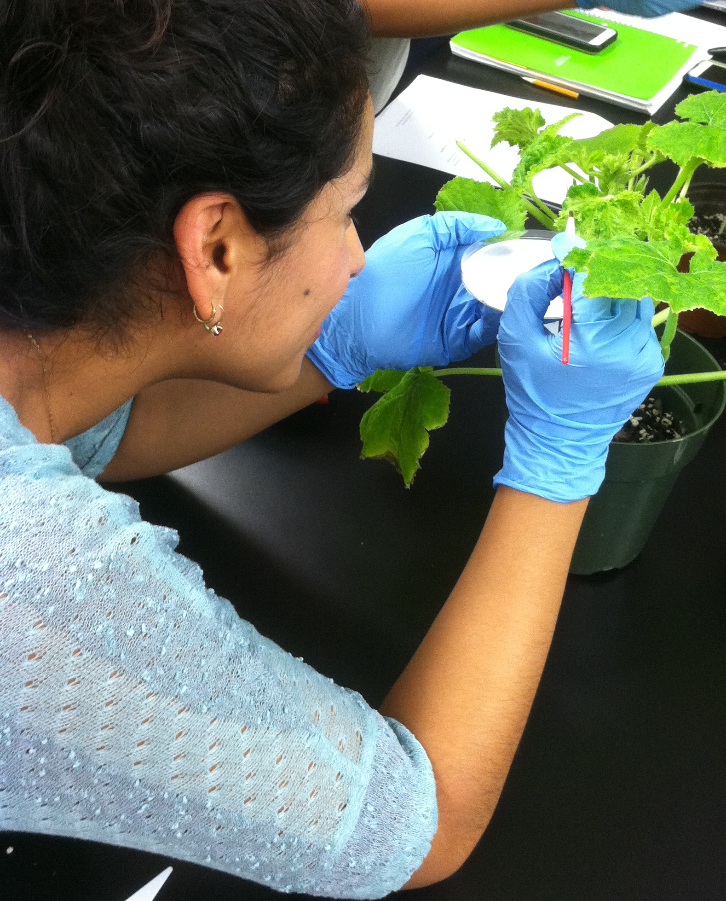
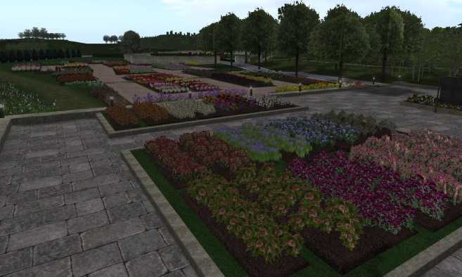
Questions:
How is content being delivered?
  In-person vs. Online?
  Techniques & Pedagogy?

Slide 7

Questions:
What do employers expect from a single PLP course?
  How do employer expectations compare with educator emphasis?
  Are we missing key course or curriculum components?
flazingo.com

Slide 8
Surveys
Educator Survey
  Demographics
  Course Profile
  Content knowledge & Skills
  Techniques
Employer Survey
  Demographics
  Expectations
  Wishes
  Complaints

Slide 9








Survey Distributions
Educator Survey
  Targeted Instructor List
  APS Teaching
  NACTA
  NABT
Employer Survey
  APS General List (US Members)
  AmericanHort
  Botanical Society of America
  National Association of Plant Breeders
  Plant Management Network
  IR-4 Project

Slide 10
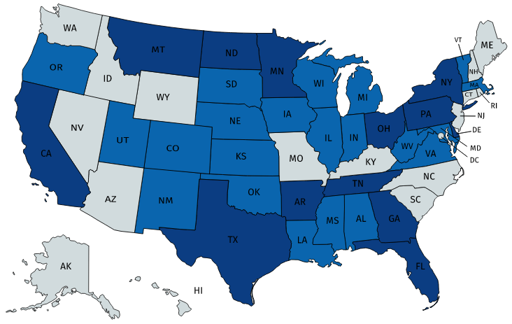


Educator Survey Highlights
65 Instructors, 79 Courses
  9 Known missing
34 in Plant Pathology Departments
89% Conduct research
  15.5% of those: no plant pathology research
20.6% (13/63) had no degree in Plant Pathology
  3 never completed a general/intro course
  1 had no formal training

Slide 11
Educator Survey Highlights
88.5% of courses met in-person (incl. blended)
  6.4% Online-only
  6.4% Both options
93.6% of courses had some lab component
  71.8% Lab required

Slide 12
Educator Survey Highlights
%

Slide 13
Employer Survey Highlights
4.02
3.98
3.84
3.80
3.80
3.78
3.71
3.64
3.55
3.53
3.51
3.48
3.45
3.42
3.36
3.26
3.23
3.20
3.20
3.17
3.16
3.00
2.94
2.92
2.78
2.68
2.56
2.49
2.48

Slide 14
Employer Survey Highlights
3.64
3.40
3.38
3.31
3.24
2.93
2.91
2.87
2.79
2.69
2.56
2.26

Slide 15
Concurrence & Conflict
Fungal Pathogen Bio
Host Resistance
Disease Cycle
Fungal Structures
Gene-For-Gene
Cultural Control
Common Fungal Diseases
Common Nematode Diseases
History of PLP
Viral Pathogen Bio
Plant Defenses
Virus Structures
Nematode Pathogen Bio
Epidemiology
Nematode Anatomy
Biological Control
Pathogenicity Factors
Common Viral Diseases
Common Bacterial Diseases
Environmental Factors
Fungal Taxonomy
Bacterial Structures
Bacterial Pathogen Bio
Pesticides & Chem Control
Koch's Postulates
Nematode Taxonomy
Principles Biotech
Viral Taxonomy
Bacterial Taxonomy
Fungal Culture Techniques
Recognition Common Diseases
Bacterial Culture Techniques
Pathogen Inoculations
Key out/ ID Fungal Pathogens
ELISA
Key out/ ID Bacterial Pathogens
Key out/ ID Nematodes
Recognition Nutrient Deff
DNA Extraction & PCR
Recognition Insects/Mites
Media Production
10%
Educators
Employers

Slide 16
Critical Skills

Slide 17
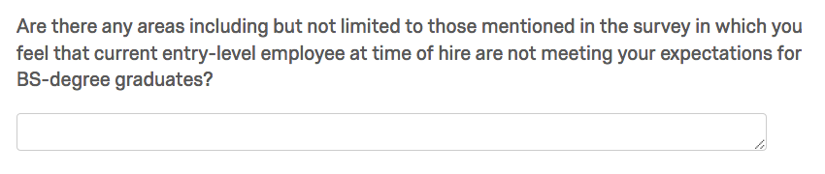
Employers’ Laments
Work Ethic,
Work Readiness
Communication
Skills
Personal attributes
Informational
Skills
Readiness to Learn
Content
Knowledge
Interpersonal Skills
Technical
Skills
Balance/
Breadth
Experience
Basic Lab Skills
Writing
Skills
Statistics
Skills
Readiness to Learn

Slide 18

Conclusions: Courses & Curriculum
Course content
  Knowledge goals well-aligned
  Skills may need greater emphasis
Curriculum content
  Work readiness
  Lab skills
  Writing
  Statistics

